Slide 1
LE26-106 What's new: Enhanced inventory analytics
Kennie Nybo Pontoppidan

Slide 2
Business Value
Set focus on supply chain risk for most sold items
Do ABC analysis in Power BI or Excel
Easier built-in reporting
Use enhanced Excel reports and built-in analysis views
Notes:
LE25-100

Slide 3
For Inventory, in 2026w1
… we have completely modernized reporting and analytics for the inventory area.
Everything you could analyze with existing reports has a new way: in Power BI, with data analysis, or with an Excel report.
  Users can track new relevant KPIs and scenarios in the updated PBI inventory apps.
  Many existing list reports have a Word and a simple Excel layout to allow customers to change the report as they need. The datasets have been enriched with the fields that are commonly added in report extensions. The legacy RDLC layouts have been deprecated.
  Many of the existing analytical reports have been marked as deprecated in 2026w1. Removal date set to 2027w2. For each report, we have specified their replacement(s).
  All existing reports have teaching tips and are documented, including deprecation and replacement options. New inventory analytics section in docs.

Slide 4
Enhanced Inventory Analytics (highlights)
New reports (Power BI and Excel) for ABC analysis
Modernized analytical reports
Added subtotals to Excel layouts for the built-in inventory reports
Added analysis tabs

Slide 5
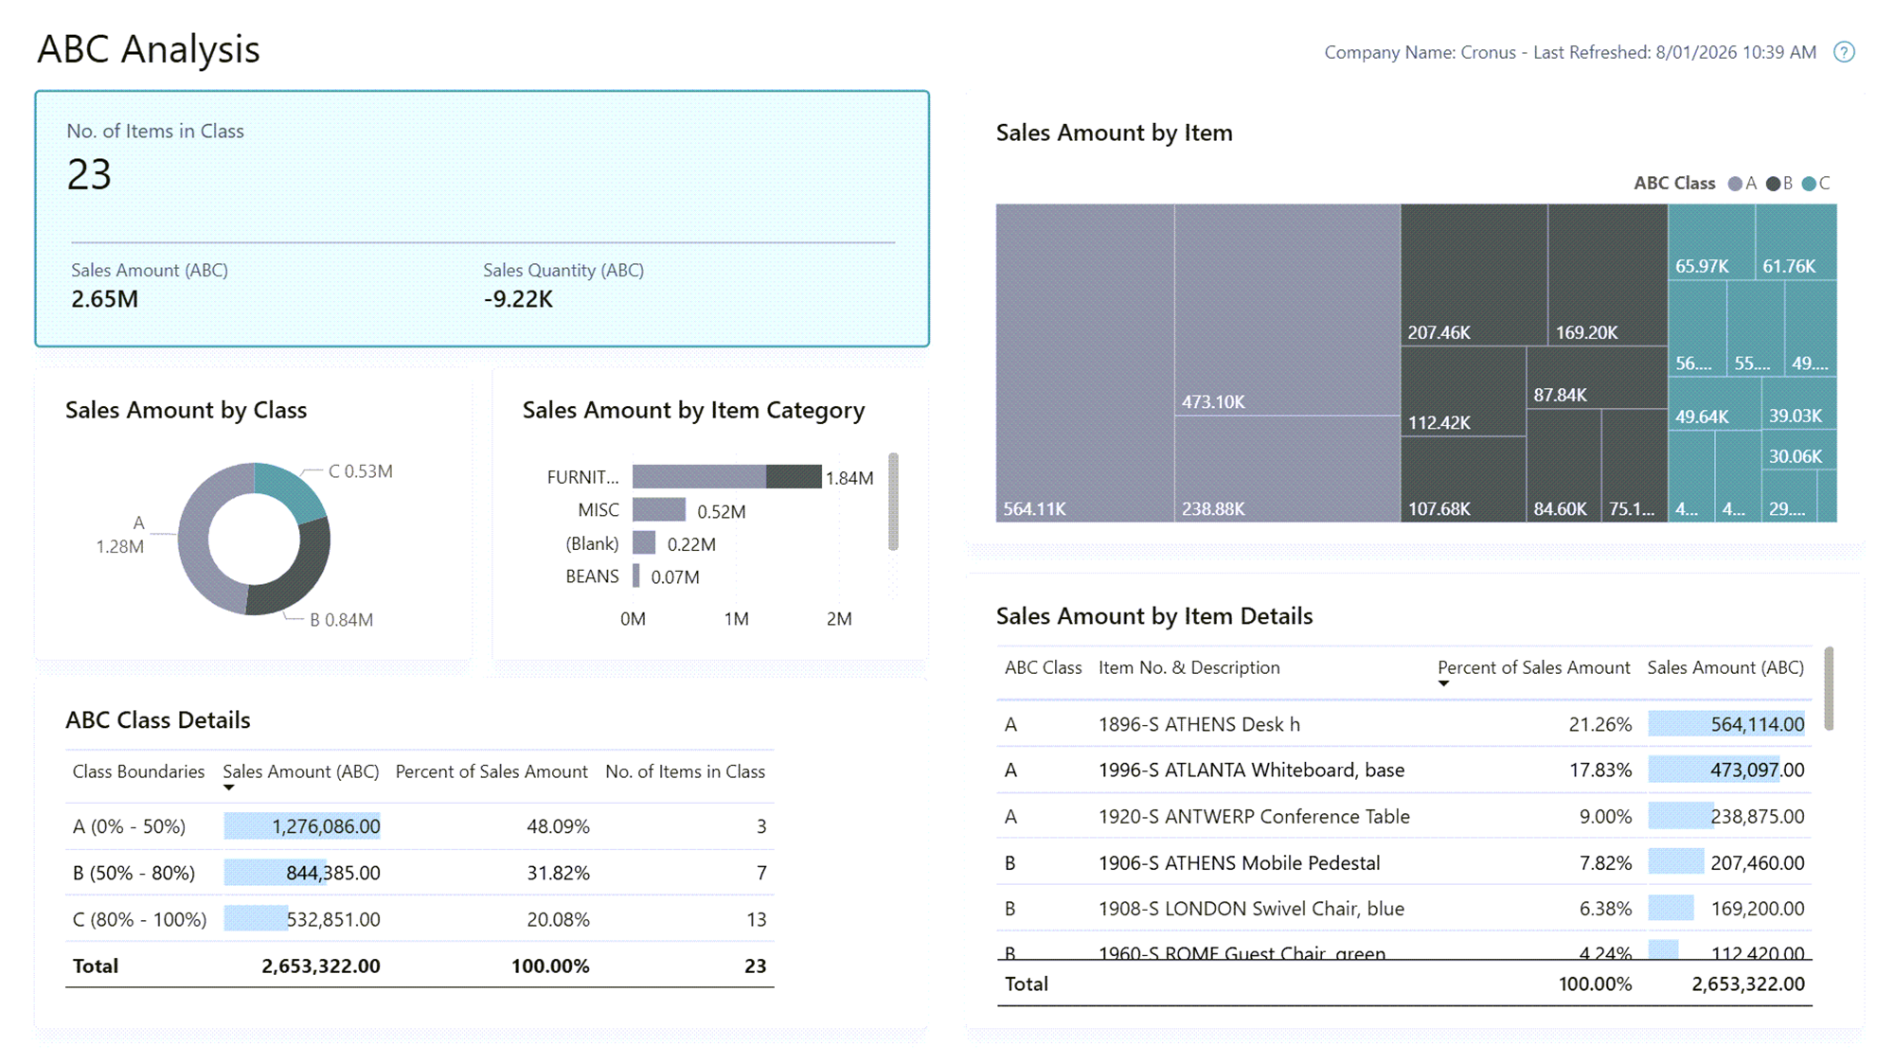
New reports for ABC analysis
Power BI
Excel (28.x)

Slide 6


Slide 7
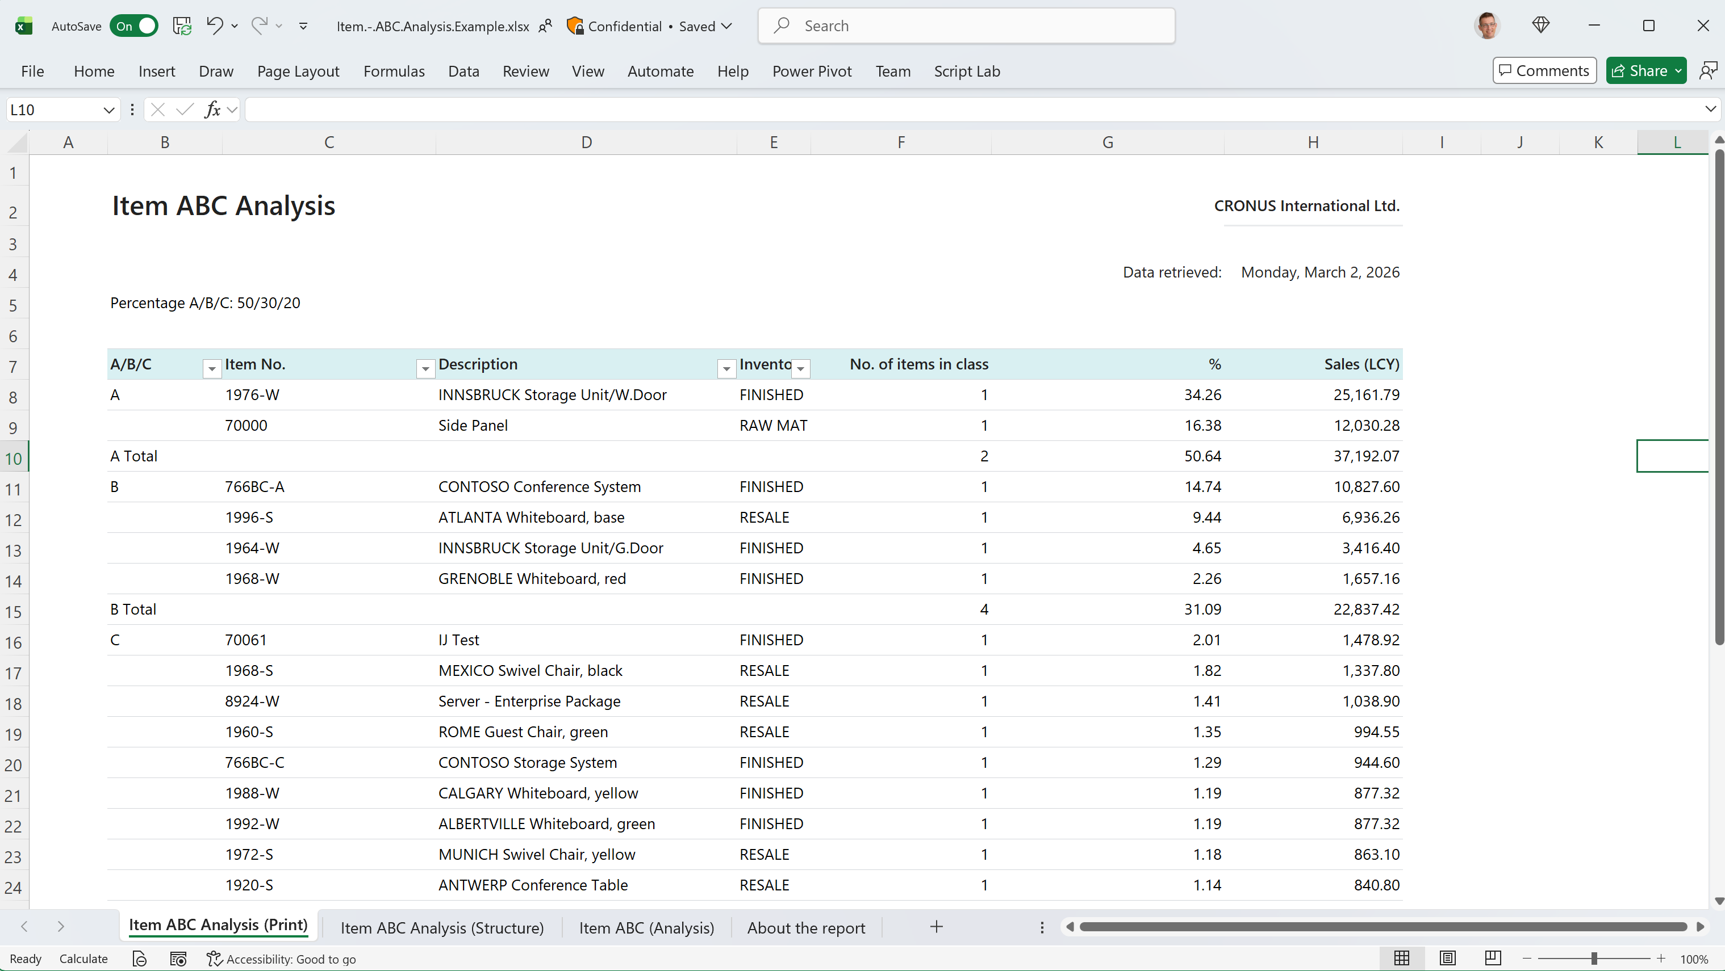

Slide 8
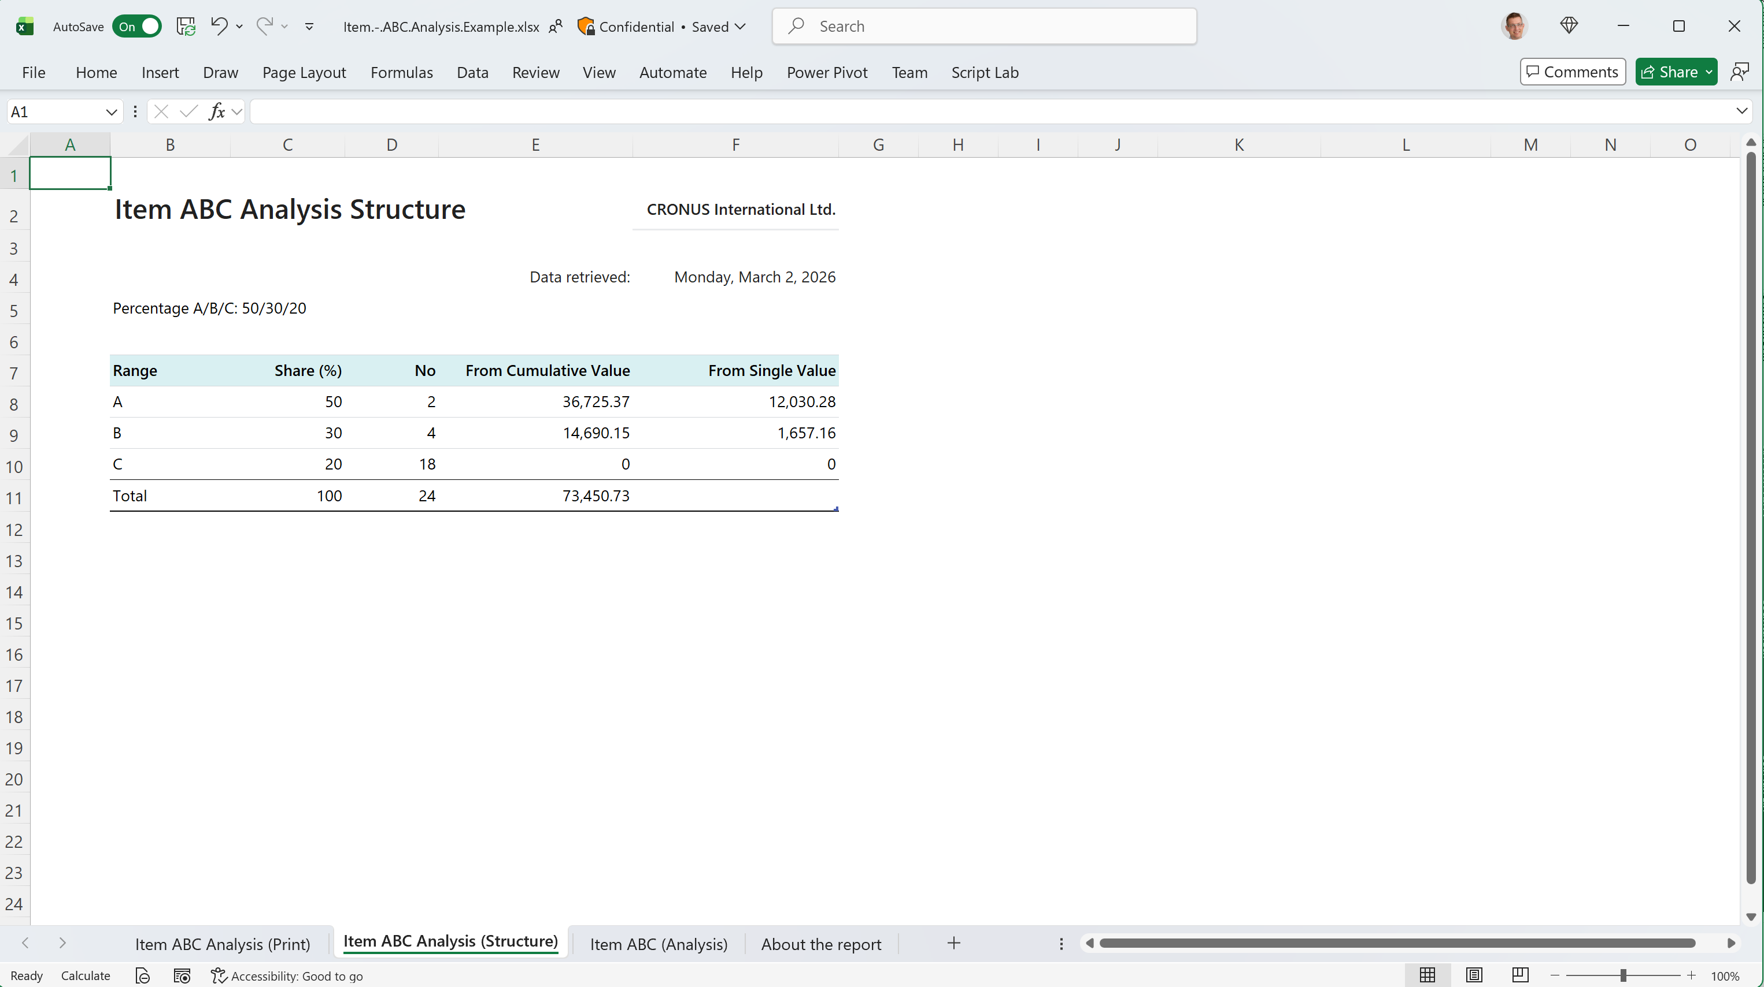

Slide 9
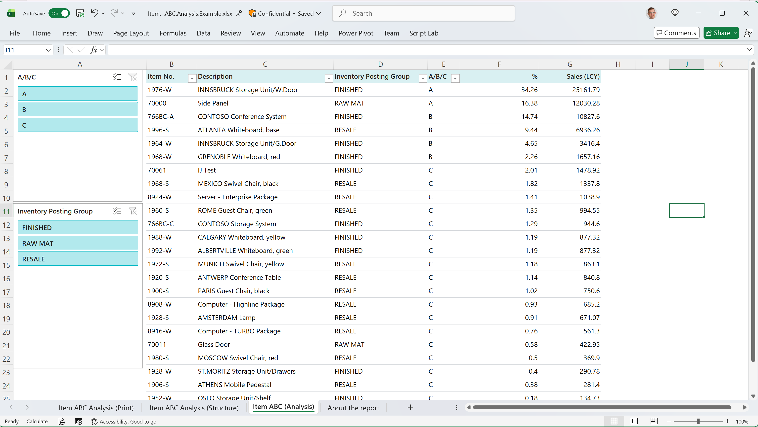

Slide 10
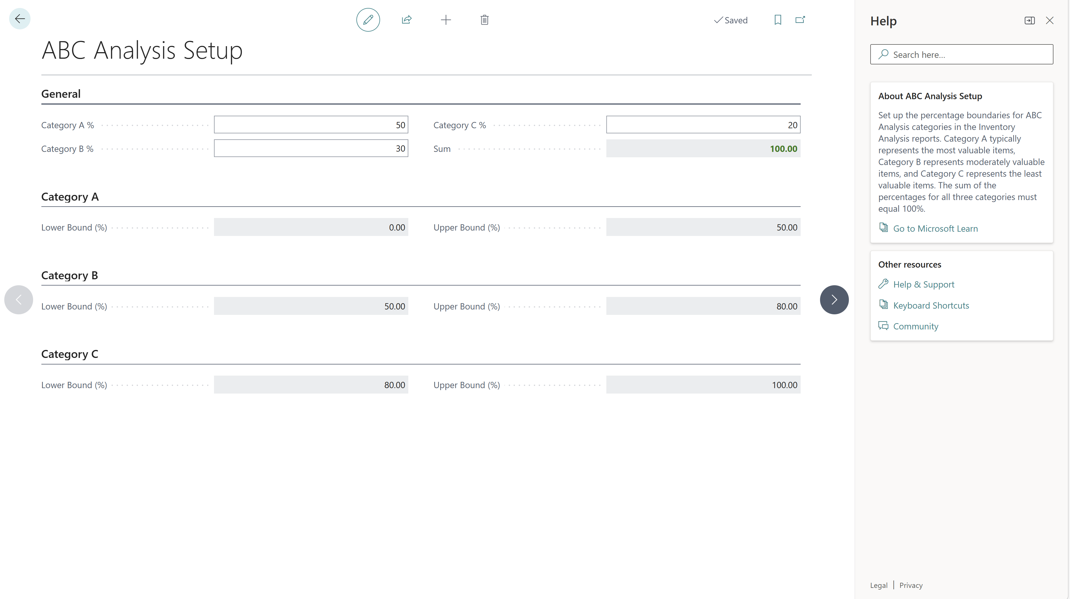
Notes:
Set up the ABC thresholds for both reports here

Slide 11
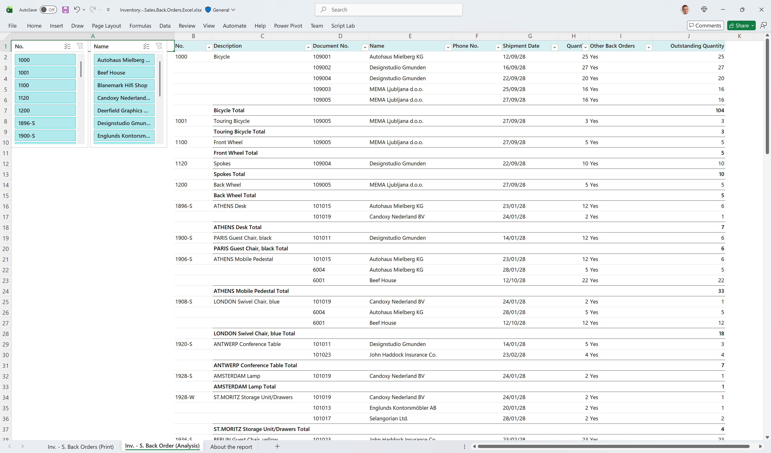
Built-in reports for Inventory
Modernized to enable
Analysis in Excel
Users can change the layouts
Improved help
in-client
articles in Microsoft Learn (documentation)

Slide 12
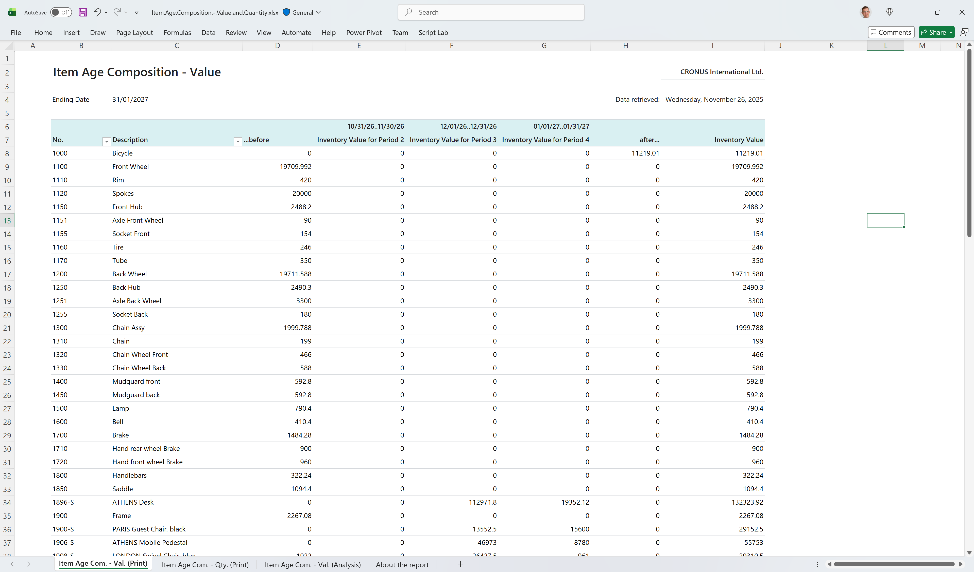
New reports
ABC analysis (28.x)
Item Age Composition by Quantity and Value

Slide 14
Notes:
It has two other worksheets

Slide 15
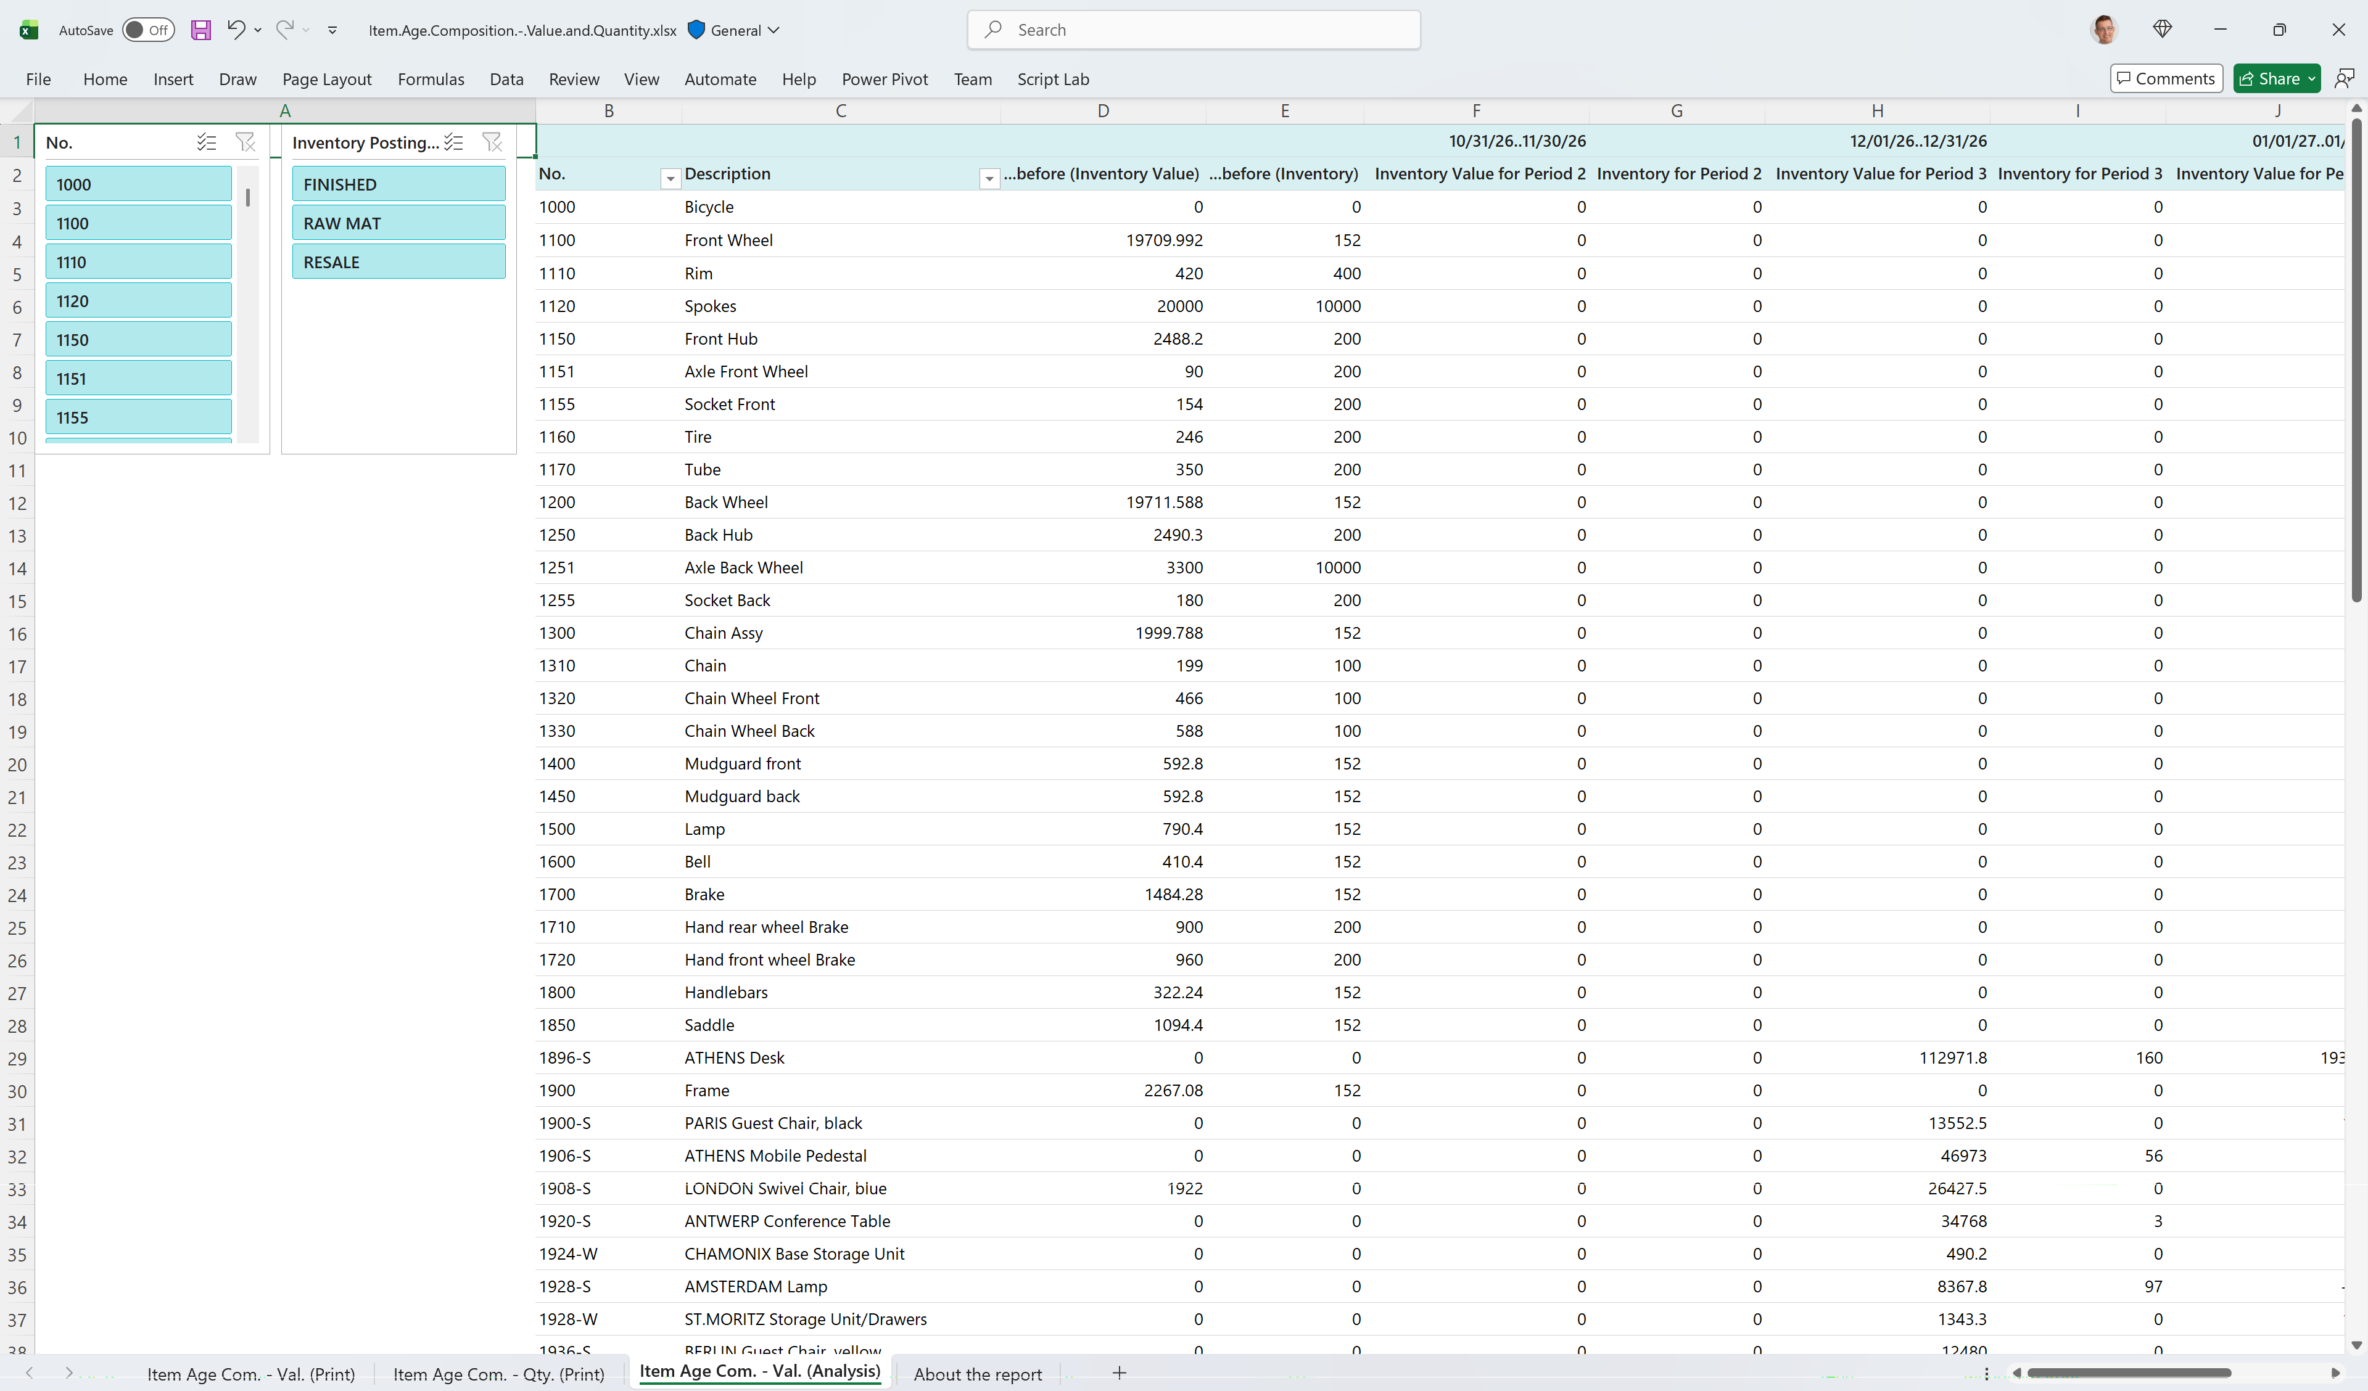
Notes:
Here is the analysis worksheet with both value and quantity

Slide 16
Inventory - Vendor Purchase
(legacy layout)
Notes:
Here is an example of a modernized report

Slide 17
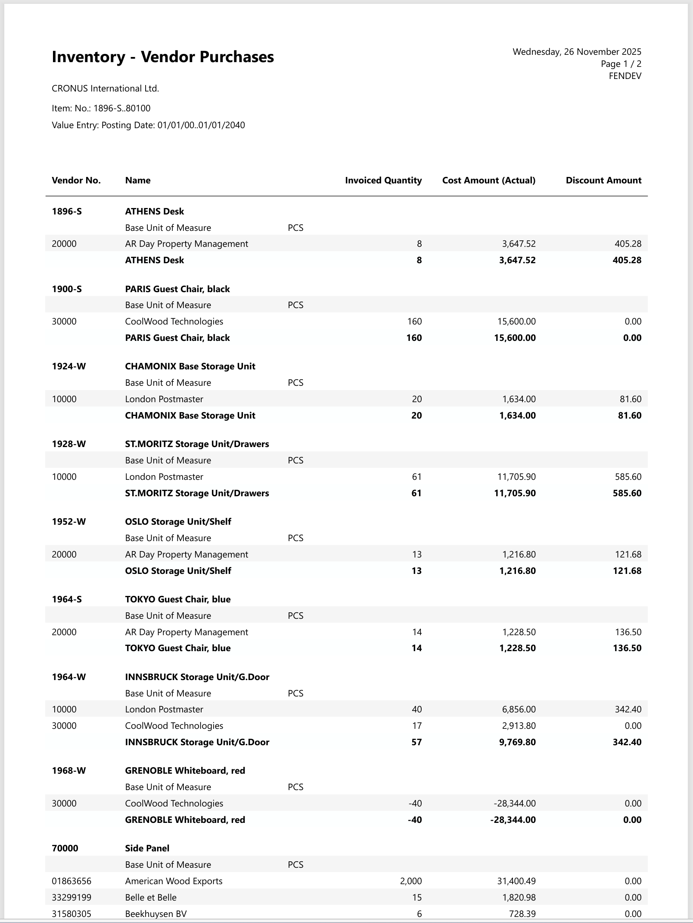
Inventory - Vendor Purchase
Word layout

Slide 18
Inventory - Vendor Purchase
Excel layout

Slide 19
Modernizing (all) analytical inventory reports (28.0)
Updated reports
Deprecate these reports
Inventory Top 10 List
Item Availability
Inventory Purchase Orders
Item/Vendor Catalog
Inventory Availability Plan
Inventory - Transaction Detail
Item Expiration - Quantity
Customer - List
Sales Statistics
Customer - Sales List
Sales Reservation Avail.

Slide 20
Added subtotals to Excel layouts for the built-in inventory reports (28.x)
Inventory - Transaction Detail
Inventory - Vendor Purchases
Inventory Order Details
Inventory Customer Sales
Inventory - Sales Back Orders

Slide 21
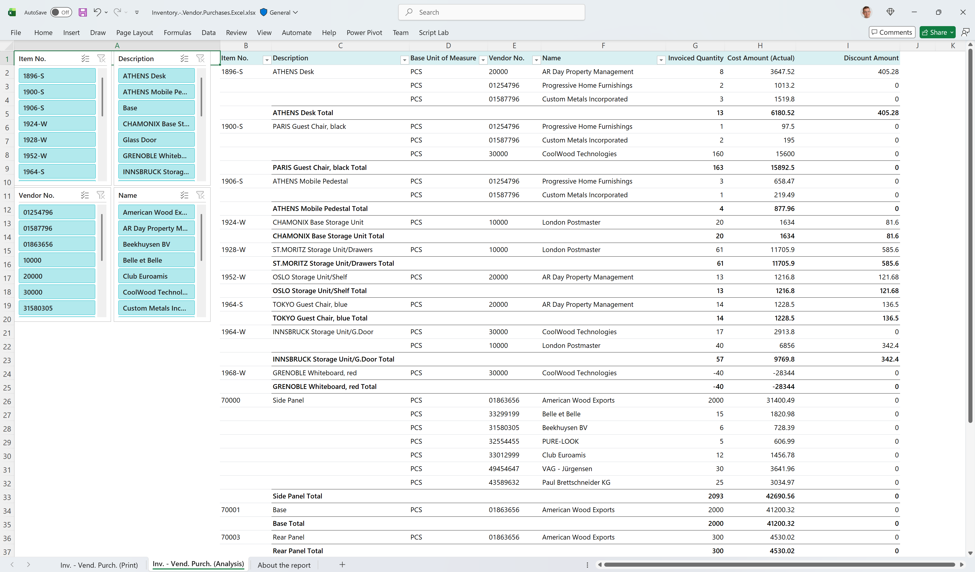

Slide 22
Analysis tabs added to inventory pages (28.x)
Item Ledger Entries
  Inventory on hand
  Inventory throughput
  Inventory movements
  Returned items by return reason

Slide 23
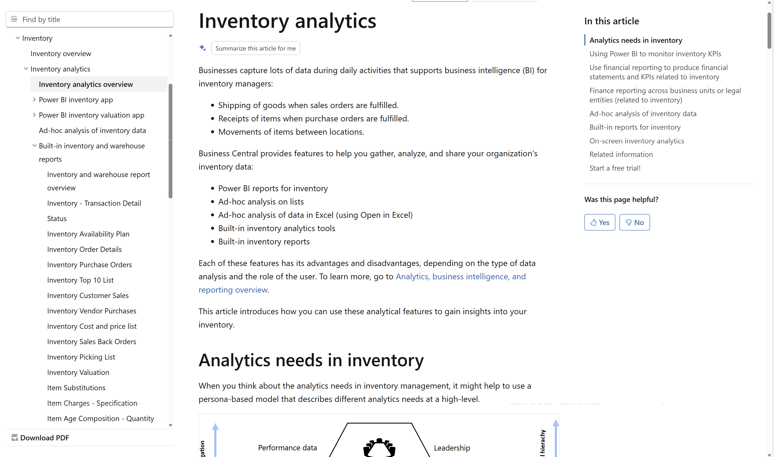
Want to learn more?
aka.ms/
bcInventoryAnalytics

Slide 25
Related sessions
What's new: Enhanced sales analytics
What's new: Enhanced finance analytics
What's new: Enhanced Financial Reporting
What's new: Enhanced subscription billing analytics
What's new: Enhanced Power BI and Excel with Business Central
What's new: Enhanced Analysis Mode
What's new: Enhanced demo data

Slide 26
General Business Central resources
Learn more!
Looking for resources?
Watch more on YouTube
aka.ms/BCAll
aka.ms/BCYouTube
Join Viva Engage to ask questions
Follow on LinkedIn
aka.ms/BCLinkedIn
aka.ms/BCVivaEngage
Join the office hours
Microsoft page for partners
aka.ms/BCOfficeHours
aka.ms/BCPartnerPortal

Slide 27



LinkedIn
Follow the weekly news and announcements
on the Microsoft Dynamics 365 Business Central page
aka.ms/BCLinkedIn

Slide 28

Watch more videos on YouTube
One-stop shop to watch Business Central videos:
  What is new
  Copilot and AI
  Short tips and tricks
  Technical deep dives
  Under the Hood podcast series
aka.ms/BCYouTube

Slide 29
THANK YOU

